Slide 1
基于Docker的高性能并行异构系统设计
开题报告 范欣 11.2017

Slide 2
Agenda
Docker Overview
Docker hub
Docker usage
CUDA
Demo
Q&A

Slide 3
Docker Overview
Basic
Docker is the world’s leading software container platform. Developers use Docker to eliminate “works on my machine” problems when collaborating on code with co-workers. Operators use Docker to run and manage apps side-by-side in isolated containers to get better compute density. Enterprises use Docker to build agile software delivery pipelines to ship new features faster, more securely and with confidence for both Linux and Windows Server apps.
Using containers, everything required to make a piece of software run is packaged into isolated containers. Unlike VMs, containers do not bundle a full operating system - only libraries and settings required to make the software work are needed. This makes for efficient, lightweight, self-contained systems and guarantees that software will always run the same, regardless of where it’s deployed.
Website: https://www.docker.com/
What is a Container
A container image is a lightweight, stand-alone, executable package of a piece of software that includes everything needed to run it: code, runtime, system tools, system libraries, settings. Available for both Linux and Windows based apps, containerized software will always run the same, regardless of the environment. Containers isolate software from its surroundings, for example differences between development and staging environments and help reduce conflicts between teams running different software on the same infrastructure.

Slide 4
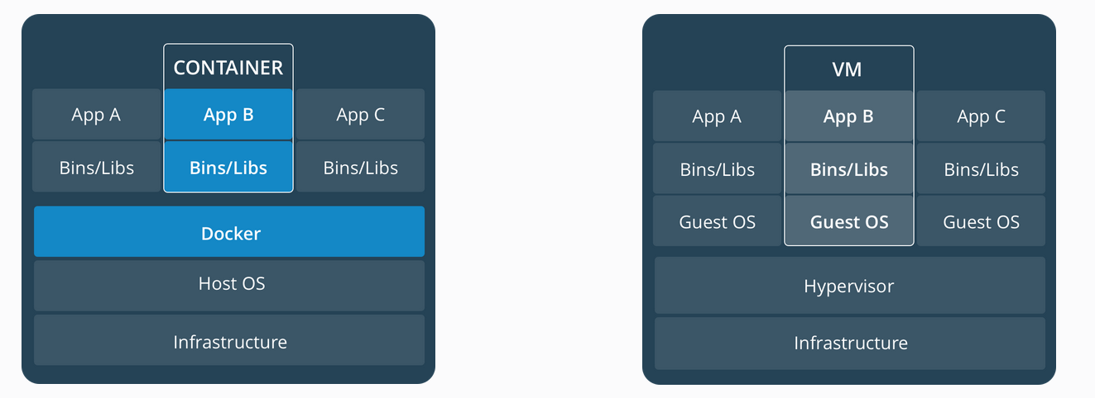
DOCKER Overview
Comparing Containers and Virtual Machines
Containers
Containers are an abstraction at the app layer that packages code and dependencies together. Multiple containers can run on the same machine and share the OS kernel with other containers, each running as isolated processes in user space. Containers take up less space than VMs (container images are typically tens of MBs in size), and start almost instantly.
Virtual Machines
Virtual machines (VMs) are an abstraction of physical hardware turning one server into many servers. The hypervisor allows multiple VMs to run on a single machine. Each VM includes a full copy of an operating system, one or more apps, necessary binaries and libraries - taking up tens of GBs. VMs can also be slow to boot.

Slide 5
Docker hub
Basic
Docker Hub is a cloud-based registry service which allows you to link to code repositories, build your images and test them, stores manually pushed images, and links to Docker Cloud so you can deploy images to your hosts. It provides a centralized resource for container image discovery, distribution and change management, user and team collaboration, and workflow automation throughout the development pipeline.
Key features of Docker hub
Image Repositories: Find and pull images from community and official libraries, and manage, push to, and pull from private image libraries to which you have access.
Automated Builds: Automatically create new images when you make changes to a source code repository.
Webhooks: A feature of Automated Builds, Webhooks let you trigger actions after a successful push to a repository.
Organizations: Create work groups to manage access to image repositories.
GitHub and Bitbucket Integration: Add the Hub and your Docker Images to your current workflows.

Slide 6
Docker usage (local)
Install Docker
https://docs.docker.com/engine/installation/linux/docker-ce/ubuntu/
Configure your Docker environment (Ubuntu 14.04)
sudo service docker stop
sudo vi /etc/default/docker
Edit DOCKER_OPTS
(DOCKER_OPTS="--dns 10.19.185.252 --dns 10.19.185.253 --bip=192.168.0.1/16 --fixed-cidr=192.168.1.0/24)
sudo service docker start

Slide 7
Docker usage (repository)
Pull/Push images from repository
Login docker repository (docker login)
default is connected to docker hub
docker search (Search the Docker Hub for images)
Manage images (docker image <command>)
pull (Pull an image or a repository from a registry)
push (Push an image or a repository to a registry)

Slide 8
CUDA:3 Ways to Accelerate Applications
Applications
Libraries
OpenACC
Programming Languages
Easiest Approach
Maximum Performance
Notes:
一般来说，开发者可以通过三种方式来进行进行GPU软件开发。
我们可以利用一些现成的函数库，这些库可能是NVIDIA开发的，也可能是第三方开发的，通常都经过相应的测试和应用。使用这些函数库，可以帮助你在开发过程中节省大量的时间和精力。
但是并非我们所有的需求都有对应的函数库，而相对的，我们希望对代码进行很小的改动就能达到在GPU进行加速的效果。这种情况下，我们可以使用基于OpenACC的编译指导。OpenACC是开放标准，和OpenMP类似，都是指导性的编译处理方案。我们在需要并行的代码前加上编译指导语言，编译器会自动将该段代码基于GPU进行并行化。
而如果我们对程序性能有很高的要求，希望能最大化地利用GPU的性能，这就需要开发人员利用CUDA直接编写程序。

Slide 9

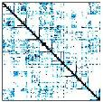

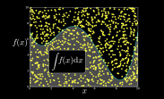








CUDA: GPU Accelerated Libraries
“Drop-in” Acceleration for your Applications
NVIDIA cuBLAS
NVIDIA cuSPARSE
NVIDIA cuFFT
NVIDIA cuRAND
NVIDIA cuSOLVER
NVIDIA cuDNN
NVIDIA NPP
nvGraph
C++ Templated Parallel Algorithms
GPU Accelerated
Linear Algebra
Matrix Algebra on GPU and Multicore
OpenCV
Notes:
在应用程序开发的过程中，开发人员会使用到各类函数库，例如BLAS基础线性代数库，FFT快速傅立叶变换等等。对于这些常用库，NVIDIA和第三方专家实现了这些库的GPU版本，并且这些库的性能往往相较于CPU版本有极大幅度的提高。
这里我们列举了一些GPU实现的函数库：
如cuBLAS：基于GPU的线性代数库。
cuSparse：稀疏矩阵的线性代数和矩阵操作库。
cuFFT：GPU加速的快速傅立叶变换函数库。
还有用于深度神经网络的cuDNN库。以及cuda8.0中开始引入的nvGraph 图处理库。
第三方的库，比如Thrust是基于GPU的一个C++ STL实现。
这些库可以大大方便开发者进行相应的程序开发。

Slide 10


CUDA: OpenACC Directives
#pragma acc data copyin(x,y) copyout(z) { ... #pragma acc parallel
{
#pragma acc loop gang vector
for (i = 0; i < n; ++i) {
z[i] = x[i] + y[i];
...
}
}
...
}
Manage Data Movement
Incremental
Multi-Platform, Single source
Interoperable, CUDA OpenCL
Performance portable
CPU, GPU, MIC (In future)
Initiate Parallel Execution
Optimize
Loop Mappings
Notes:
正如我之前提到的一样，有时候我们并不能找到需要的函数库，这个时候我们需要自己开发相应的功能。
但是有些时候，开发人员可能需要更关注于自己需要解决的问题；
或者像在科学计算领域，并非每个人都同时是物理问题和计算编程的专家。
这个时候OpenACC提供了一个性能和代码修改量之间的一个平衡。
关于OpenACC NVIDIA有单独的介绍。这里不再赘述。

Slide 11
Demo

Slide 12
Q&A
Thank you!

